Slide 1
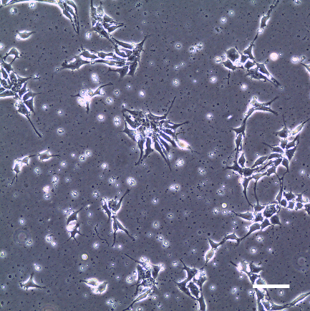
CS10
IRI-A
IRI-B
iPSC-4
iPSC-5
iPSC-6

