Slide 1
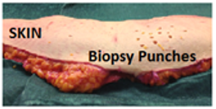
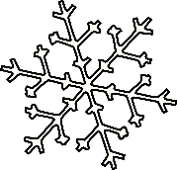
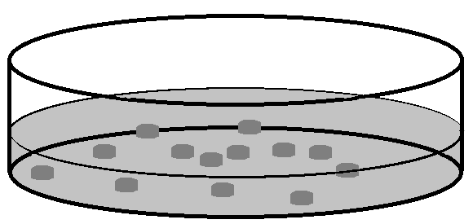
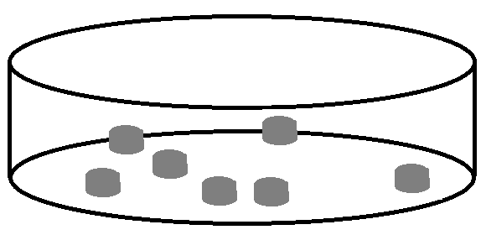
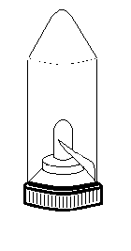
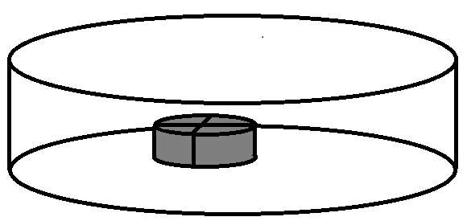
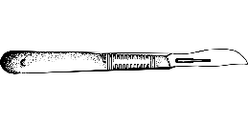
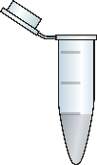
Skin biopsies
Dissociation techniques
PASSAGE 1
P2
P3
P4
P5
P6
P7
P8
P9
PASSAGE 10
COLL (n = 3)
PHY (n = 3)
GM (n = 3)
NS (n = 3)
+ collagenase
+
+
CS10
Cryopreservation
DGFD

